Slide 1

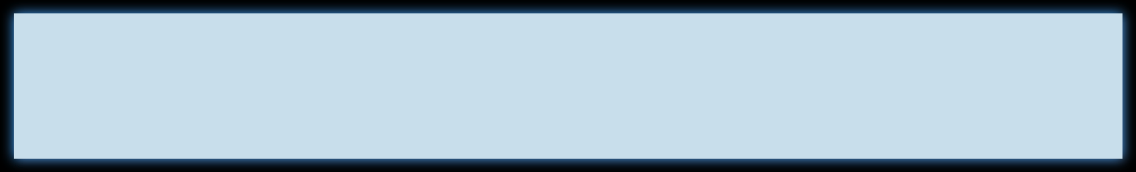

Codebasics Resume Project Challenge #6
Power BI Desktop

Slide 2
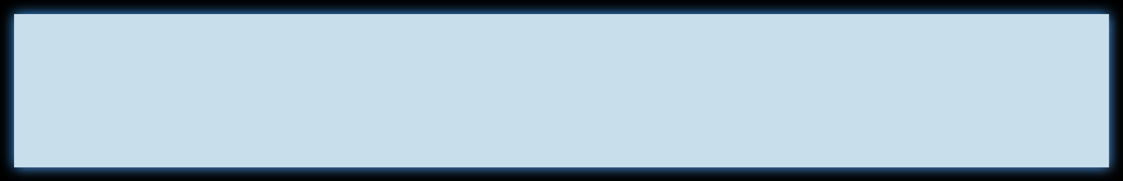

#6 Challenge : Provide Insights to the Marketing Team in Food & Beverage Industry
Power BI Desktop
CodeX, a German beverage company, recently launched its energy drink in 10 cities in India.
The Marketing team is focused on increasing brand awareness, market share, and product development in the Indian market.
To gather insights, the team conducted a survey among 10,000 respondents in the 10 cities where the energy drink was launched.
Check the “Primary_Secondary_Insights.pdf” and answer the questions by analyzing the data provided. You can use any tool of your choice (Python, SQL, PowerBI, Tableau, Excel, PowerPoint)

Slide 3
Power BI Desktop
Agenda
Requirements(tools used in project)
Answering Questions(project task)
Recommendation for CodeX
Conclusion

Slide 4
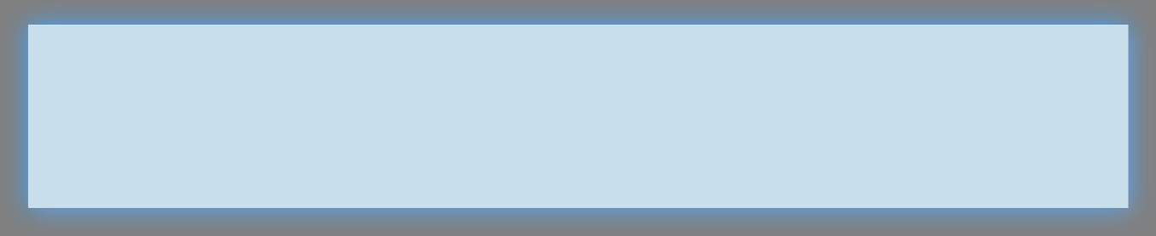

#Tools Used for project
Power BI Desktop
PowerBI, PowerPoint, OBS, DaVinci Resolve
PowerBI - Data Cleaning, Stacked Bar Chart, Stacked Column Chart, Pie Chart, Donut Chart, Map, Funnel, etc.
PowerPoint- Presentation creation, image editing, etc.
OBS - Facecam recording, Screen Recording , Audio Recording, etc.
DaVinci Resolve - Video editing

Slide 5
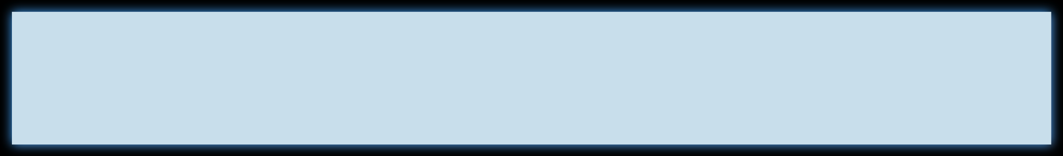

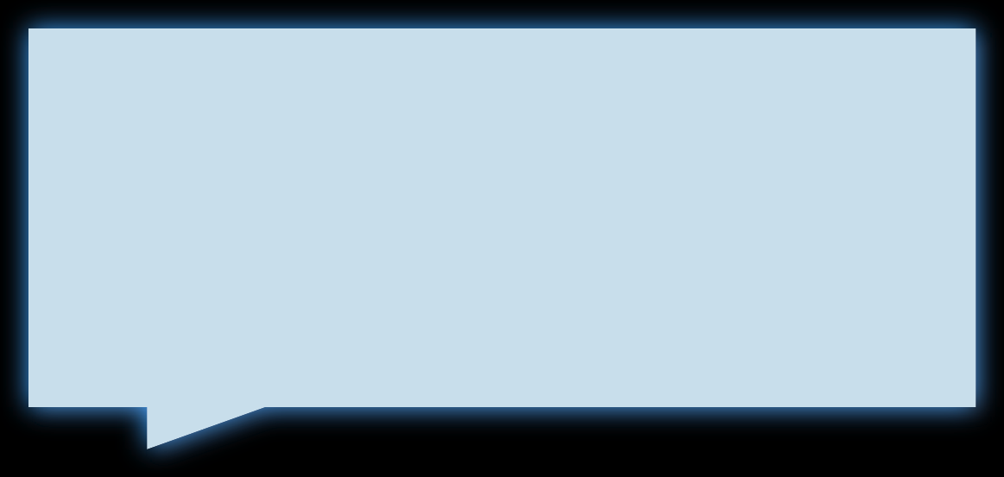

a. Who prefers energy drink more? (male/female/non binary?)
Power BI Desktop
(1)
So, the answer is male with 60% as you can see in Pie Chart
5.07%
Male Female
Non-binary
34.55%
60.38%

Slide 6
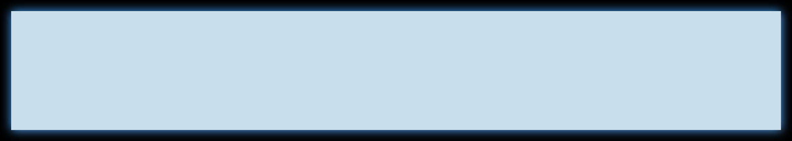

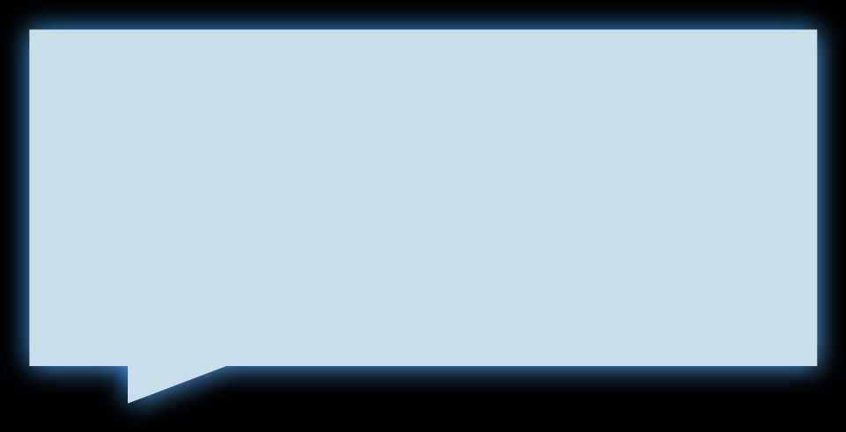
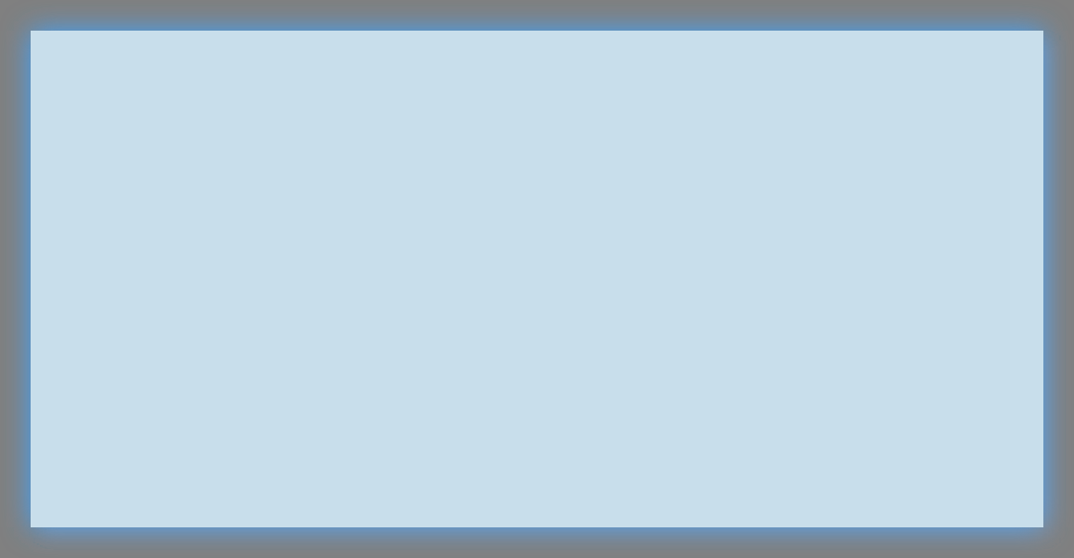

b. Which age group prefers energy drinks more?
Power BI Desktop
(1)
90%+
Answer is 19-30 with more than 5.5k,
5.5K
2.4K
More than 90% of the population belongs to the age group between 15 and 45 years.
1.5K
0.4K
0.2K
19-30
31-45
15-18
Age-Group
46-65
65+

Slide 7
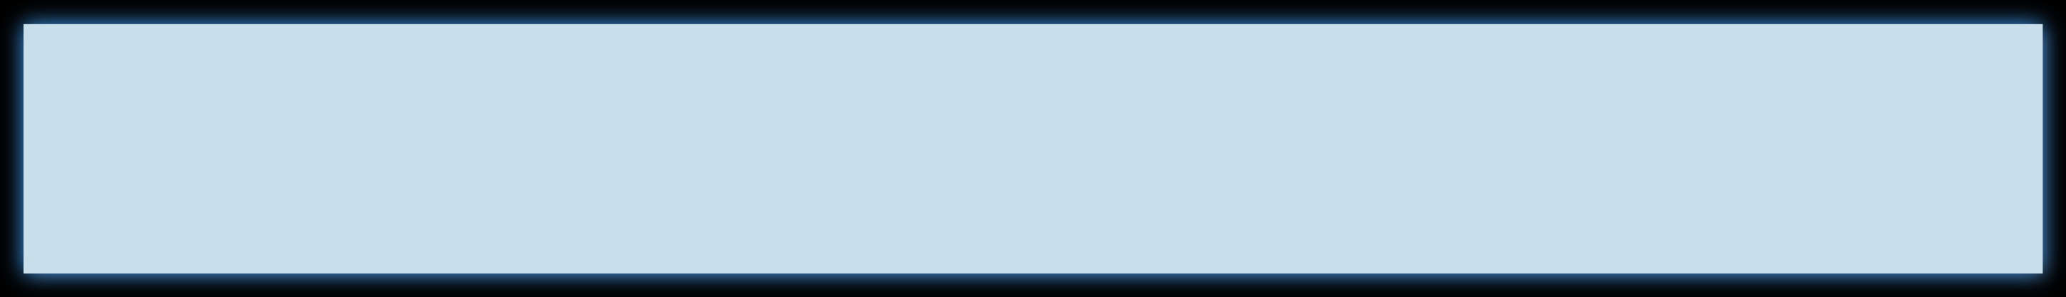


c. Which type of marketing reaches the most Youth (15-30)?
Power BI Desktop
(1)
Online ads |  |  |  | 3373
TV commercials |  |  |  | 1785 Answer is Onli
Other |  |  | 702 | 15-30
Outdoor billboards |  |  | 702
Print media |  | 446
ne ads
For age group of

Slide 8
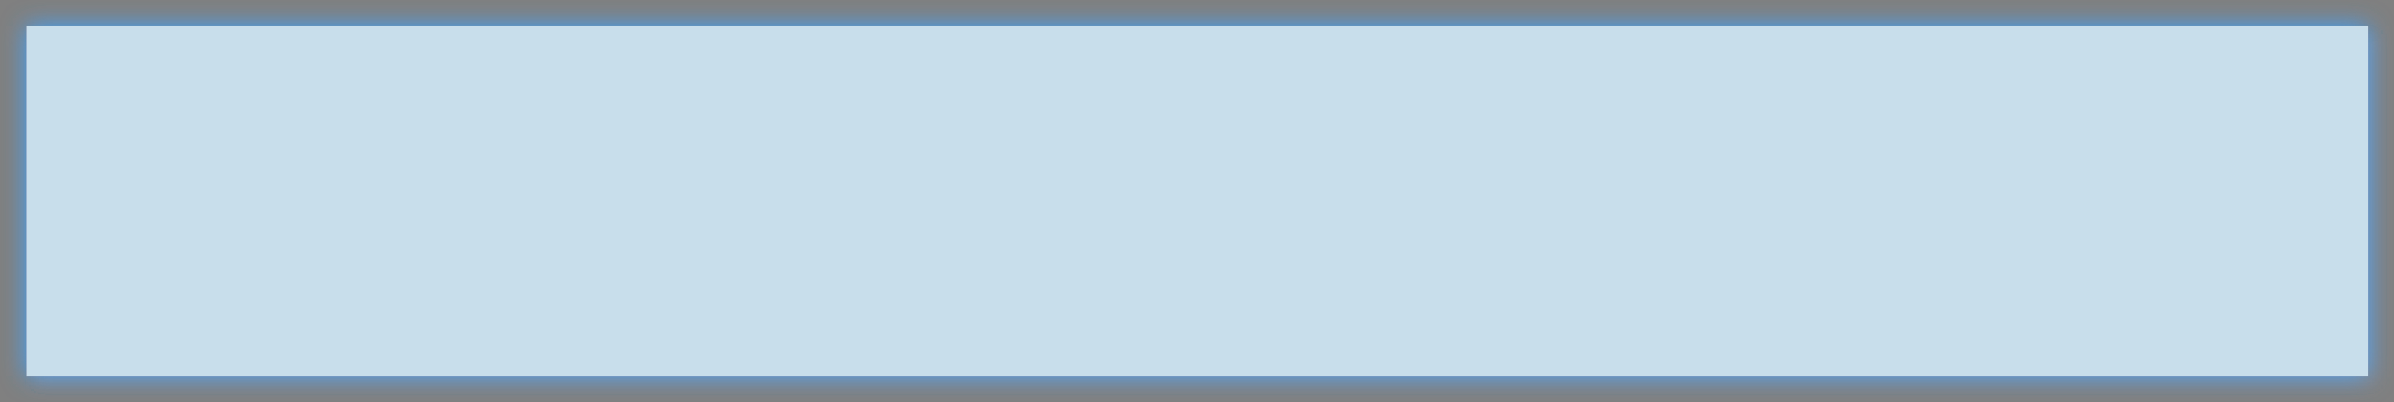

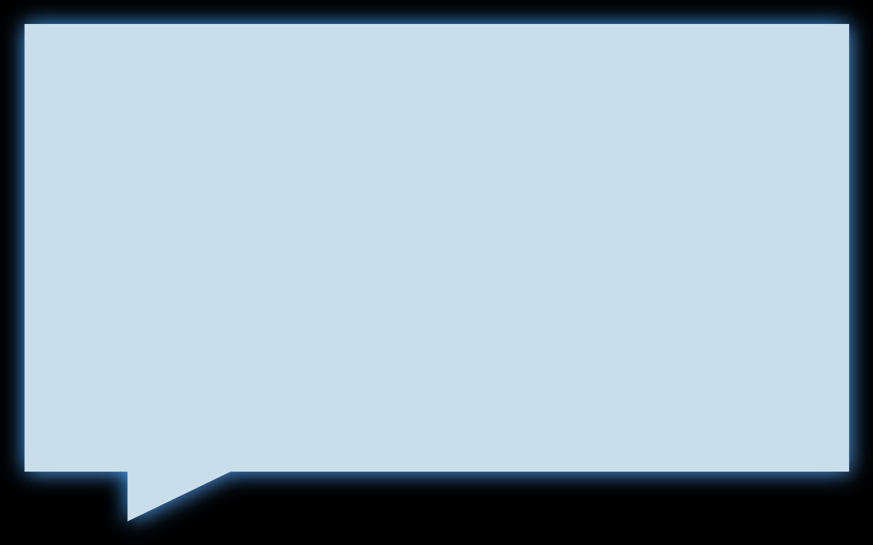
a. What are the preferred ingredients of energy drinks among respondents?
Power BI Desktop
(2)
Caffeine
38.96%
Vitamins
25.34%
Sugar
20.17%
Caffeine is the most preferred ingredient in
Guarana
15.53%
energy drinks, while Guarana
is the least preferred.

Slide 9
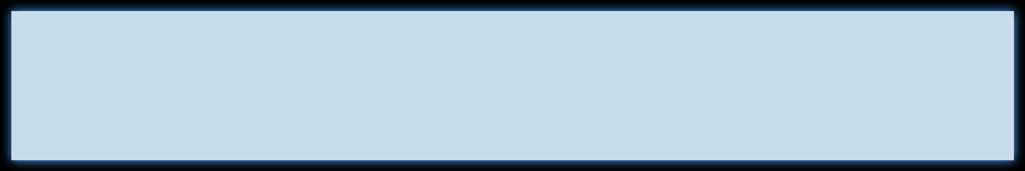


b. What packaging preferences do respondents have for energy drinks?
Power BI Desktop
(2)
Based on the donut chart, 39.8% of respondents prefer compact and portable cans, while 30.5% prefer innovative bottle designs for packaging.
30.5%
39.8%
Compact and portable cans Innovative bottle design Collectible packaging
Eco-friendly design Other
4.9%
9.8%
15.0%

Slide 10
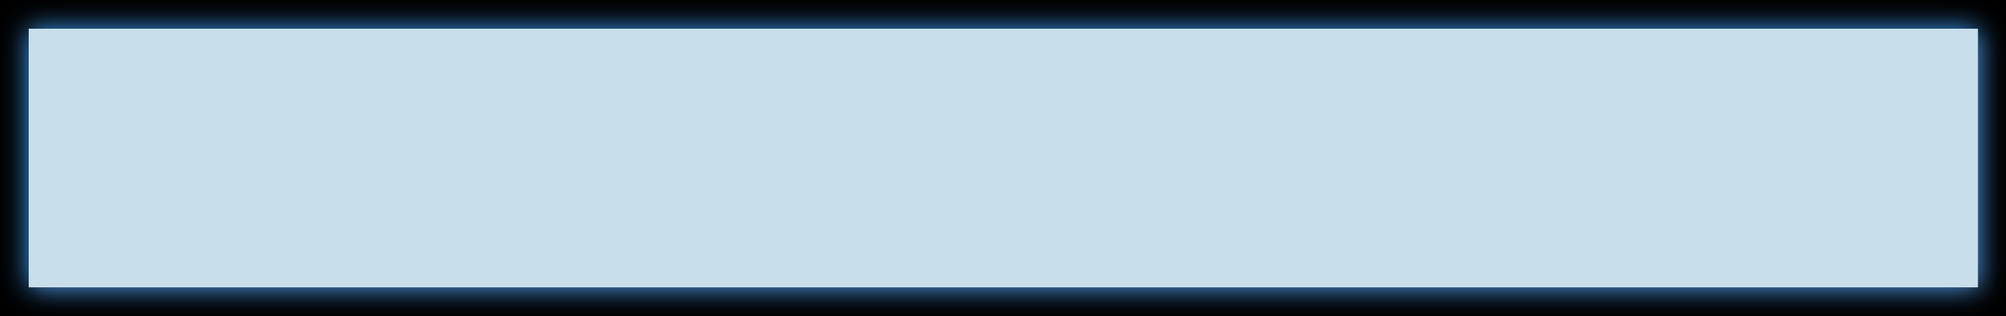



a. Who are the current market leaders?
Power BI Desktop
(3)
Cola-Coka
2538
Bepsi
2112
Gangster
1854
According to the bar chart, the current market leaders are Cola- Coka, Bepsi, and Gangster, while our product CodeX holds the fifth position.
Blue Bull
1058
CodeX
980
Sky 9
979
Others
479

Slide 11
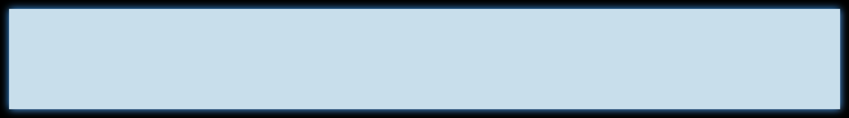

b. What are the primary reasons consumers prefer those brands over ours?
Power BI Desktop
(3)
26.5%
20.1%
19.1%
17.5%
16.8%
Brand reputation
Taste/flavor preference
Availability
Effectiveness
Other

Slide 12
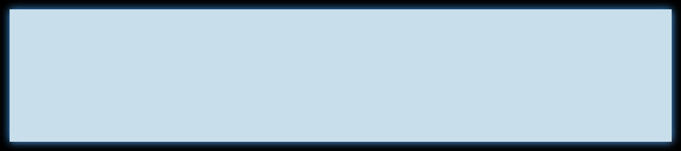

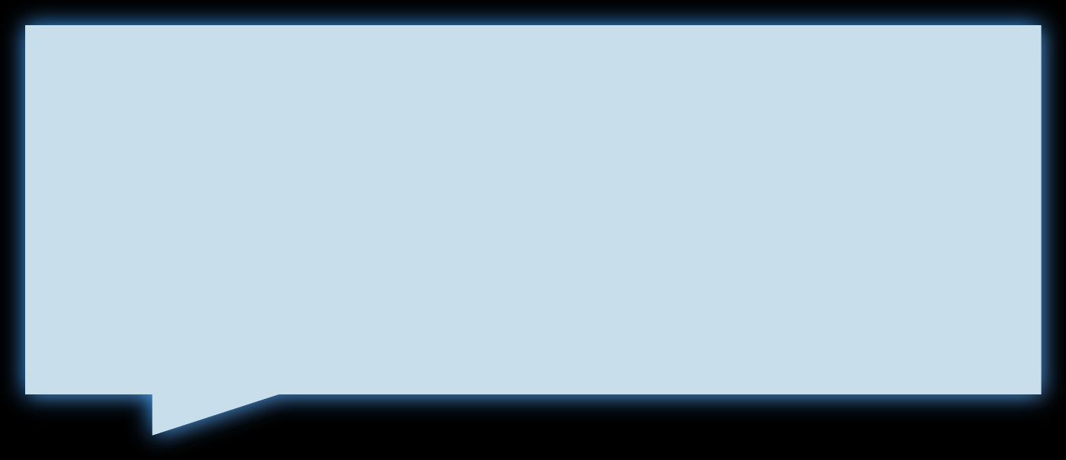
a. Which marketing channel can be used to reach more customers?
Power BI Desktop
(4)
Based on the column chart, online ads are the most effective way to market our energy drink.
4.0K
2.7K
1.2K
1.2K
0.8K
Online ads
TV
commercials
Outdoor billboards
Other
Print media

Slide 13


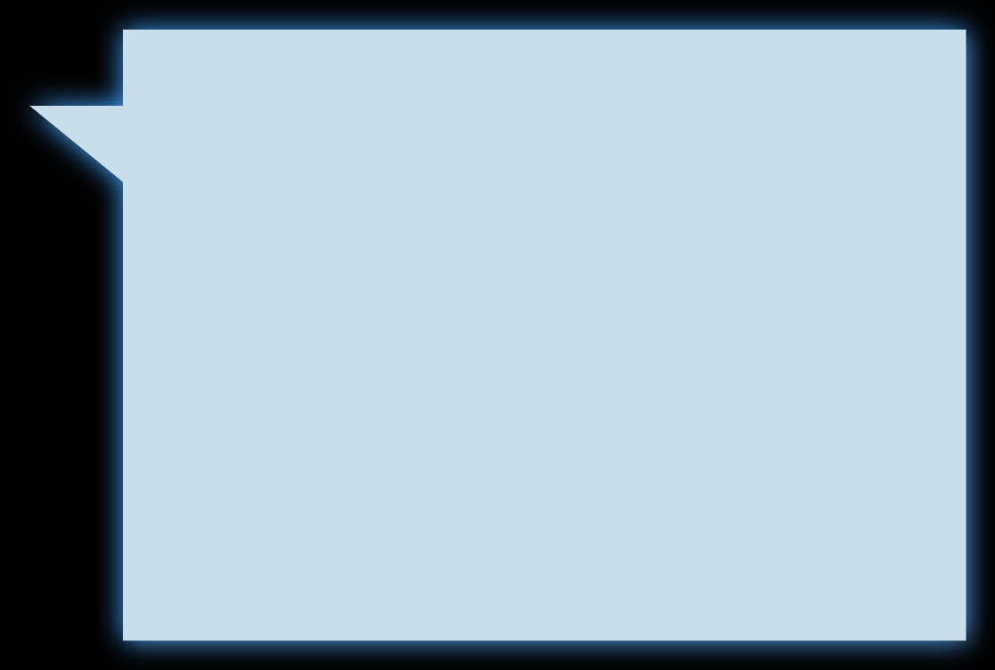

b. How effective are different marketing strategies and channels in reaching our customers?
Power BI Desktop
(4)
## With 15 to 45-year-olds comprising 90% of the market, let's explore which marketing strategies are effective.
5.5K
Online ads |  |  |  | 3.9K
TV commercials |  |  |  | 2.5K
Outdoor billboards |  |  | 1.1K
Other |  |  | ^{1.1K} chart, online ads are
Print media |  | 0.8K | the most effective
2.4K
Based on the bar
1.5K
0.4K
0.2K
way to market our energy drink.
19-30
31-45
15-18
46-65 65+
Age-Group

Slide 14
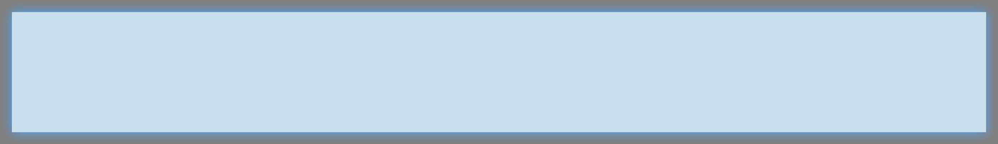


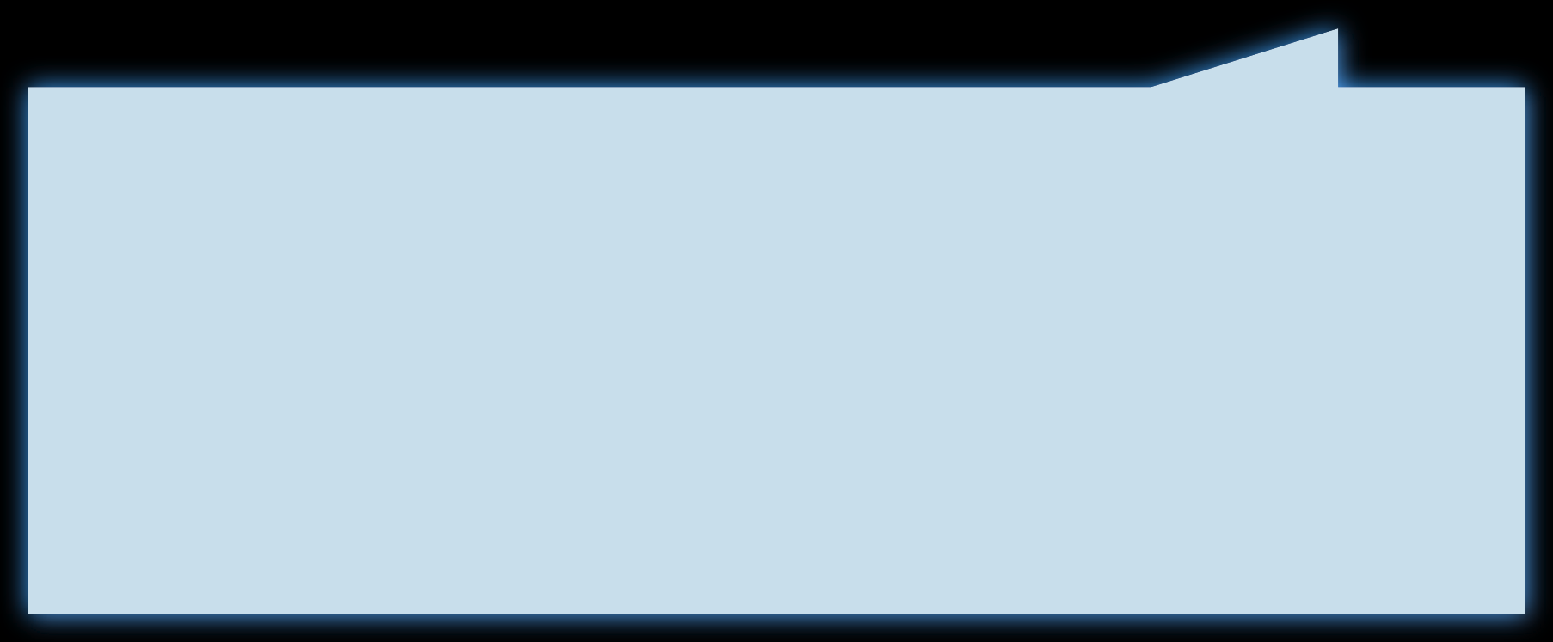
Power BI Desktop
(5)
a. What do people think about our brand? (overall rating)
3.3
Neutral
According to the feedback, respondents perceive our energy drink as Neutral with an average rating of 3.3. However, it is concerning that 55.5% of respondents have never heard of our energy drink.
Heard Before
1 5
44.5%
No Yes
55.5%

Slide 15
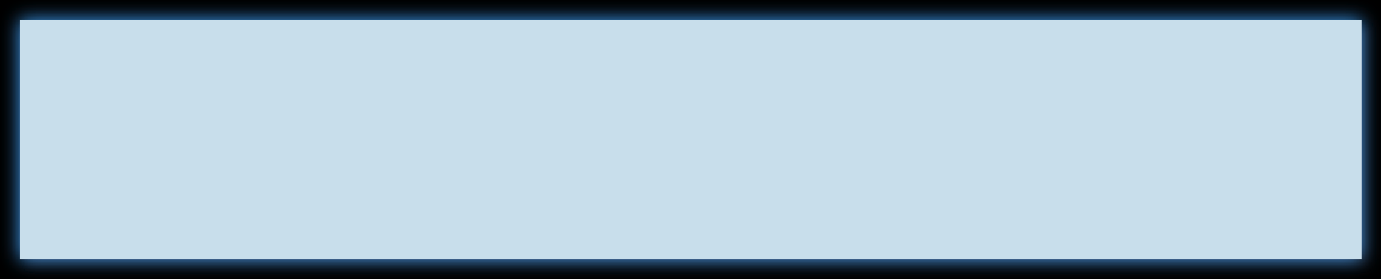





b. Which cities do we need to focus more on?
Power BI Desktop
(5)
Tier 1
Tier 2
Total Rep.
Yes-No No Yes
Based on the column chart, it is evident that
cities such as Lucknow, Pune, Delhi, Kolkata, Ahmedabad, and Jaipur have the lowest number of respondents. This indicates the need for focused marketing efforts in these cities.
2.8K
1.8K
1.5K
0.9K
0.9K
0.6K
0.5K
0.4K
0.4K
Bangalore
Mumbai
Chennai
Pune
Kolkata
Delhi
Jaipur
Lucknow
Hyderabad
Ahmedabad
Mumbai
Delhi
Lucknow
Jaipur
Kolkata
Pune
Chennai
Bangalore
Ahmedabad
Hyderabad

Slide 16

b. Which cities do we need to focus more on?
Power BI Desktop
(5)
Tier 1
Tier 2
Total Rep.
Yes-No No Yes
Based on the column chart, it is clear that
Mu2.8mK
bai and Delhi have a higher number of
respondents who have heard about our brand
1.8K
compared to^{1.5K}those who haven't. The green color
0.9K
0.9K
represents "Yes" (heard about the brand) and
0.6K
0.5K
0.4K
0.4K
the red color represents "No" (haven't heard about the brand).
Bangalore
Mumbai
Chennai
Pune
Kolkata
Delhi
Jaipur
Lucknow
Hyderabad
Ahmedabad
Mumbai
Delhi
Lucknow
Jaipur
Kolkata
Pune
Chennai
Bangalore
Ahmedabad
Hyderabad

Slide 17
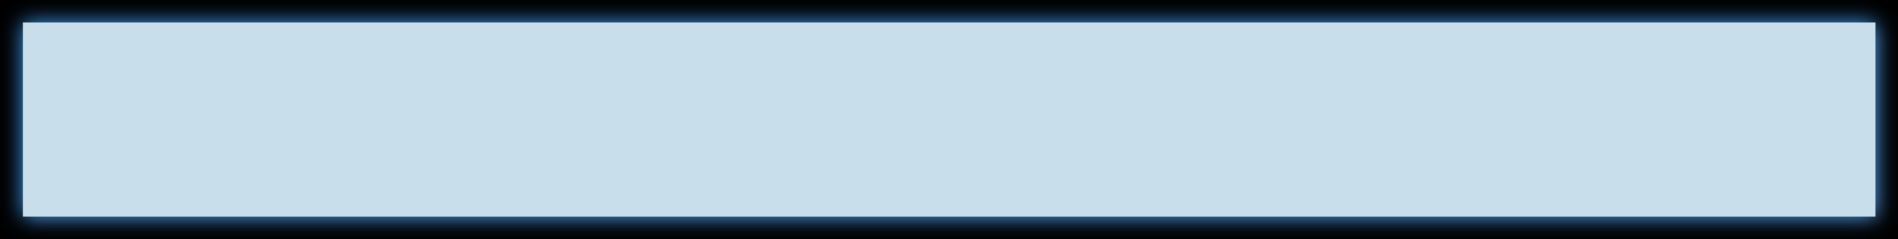

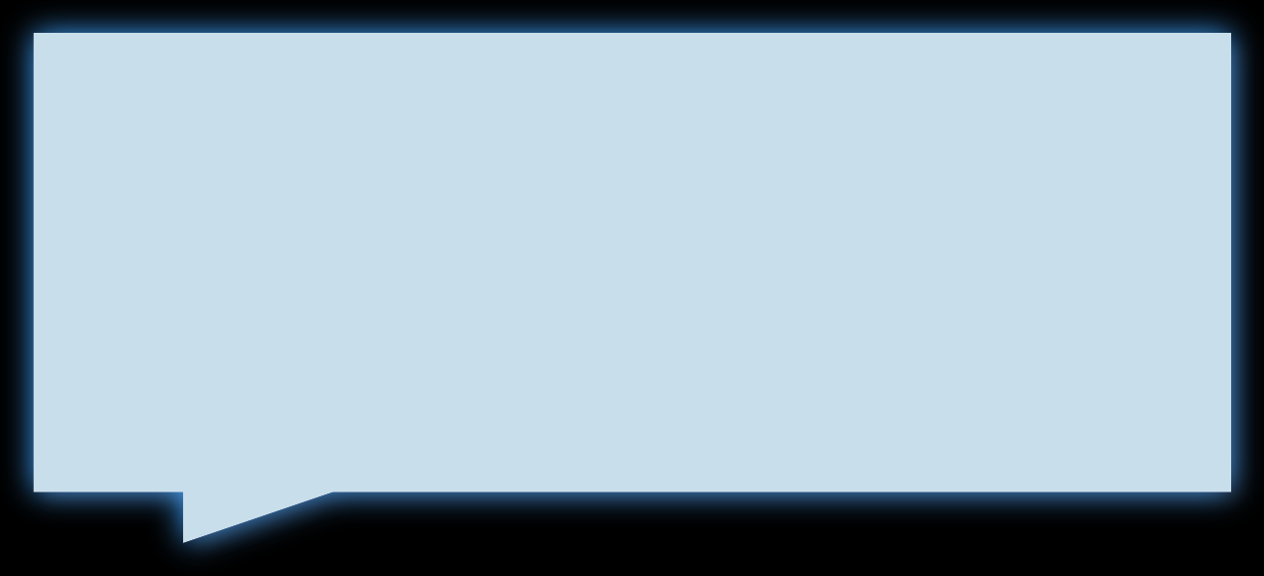

a. Where do respondents prefer to purchase energy drinks?
Power BI Desktop
(6)
According to the funnel chart, the majority of respondents expressed their preference to purchase our
product from supermarkets.
Supermarkets
44.94%
Online retailers
25.50%
Gyms and fitness centers
14.64%
Local stores
8.13%
Other
6.79%

Slide 18
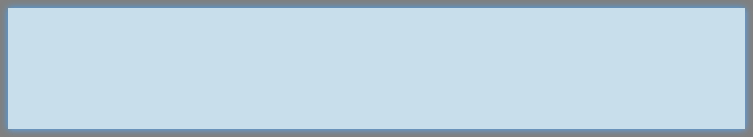




b. What are the typical consumption situations for energy drinks among respondents?
Power BI Desktop
(6)
+ people using Energy drink while
Sports/exercise
4.5K
Studying/working late
3.2K
Social outings/parties
1.5K
Other
0.5K
Driving/commuting
0.3K

Slide 19
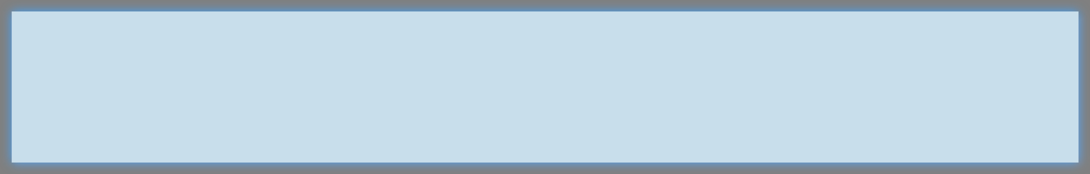



c. What factors influence respondents' purchase decisions, such as price range and limited edition packaging?
Power BI Desktop
(6)
Increased energy and focus
3.6K
39.5%
20.3%
To combat fatigue
2.4K
No Yes
Not Sure
To enhance sports perfor…
1.6K
To boost performance
1.5K
40.2%
Other
0.9K
4.3K
The main purpose of energy drink consumption among respondents is to enhance energy and focus. The
majority of them do not consider limited edition
packaging as a significant factor, although 40% do
care about it. Additionally, most respondents prefer energy drink prices to be between Rs 50-100.
3.1K
1.6K
1.0K
50-99
100-150
Above 150
Below 50

Slide 20

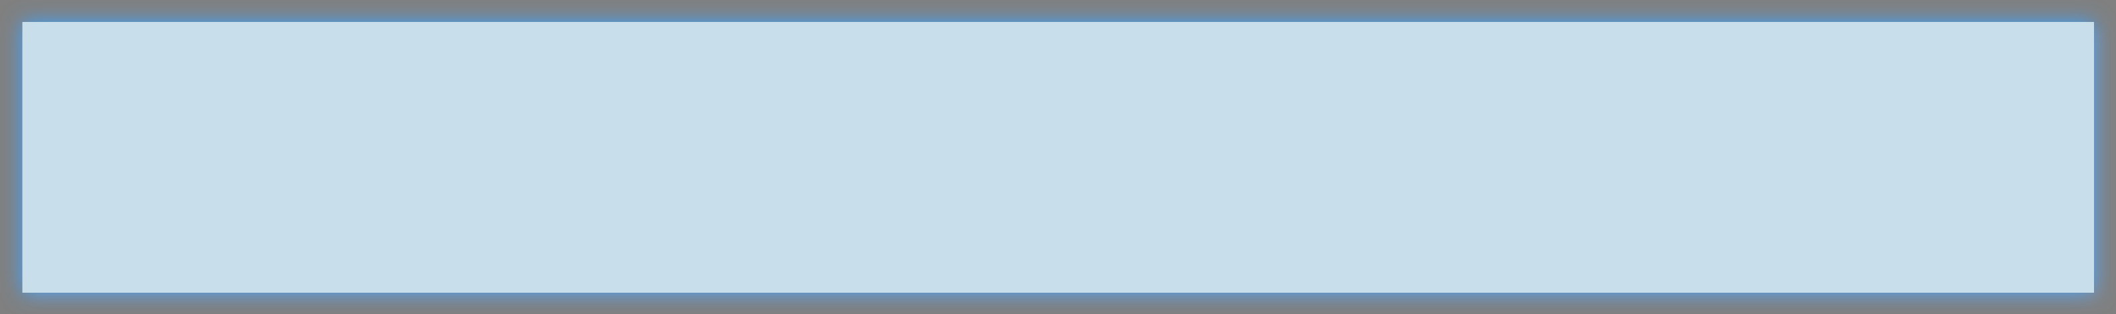




a. Which area of business should we focus more on our product development?
Power BI Desktop
(7)
Health Concerns
Health Concerns
3.0K
39.55%
Reduced sugar content
39.55
%
Reduced sugar content
3.0
Yes No
K
Yes
60.45%
No
The ma_{M}in_{ore}pu_{na}r_{t}p_{u}o_{ra}s_{l}e_{in}o_{gr}f_{ed}e_{ie}n_{n}e_{ts}rgy drink consumption among _{2.5K}
60.45
The main purpose of energy drink consumption among
%
More natural ingredients
2.5
respondents is to enhance energy and focus. The
K
respondents is to
enhance energy and focus
. The
55.2%
majority of them do not consider limited edition
packagin^{W}g^{id}a^{e}s^{r r}a^{an}s^{g}i^{e}gn^{of}if^{f}i^{l}c^{av}aºn^{r}t^{s} factor, although 40% d²o^{.0K}
care about it. Additionally, most respondents preferz
majority of them do not consider limited edition
55.2
%
Wider range of flavors
2.0
K
packaging as a significant factor, although
40
%
do
care about it. Additionally, most respondents prefer
energy d_{H}ri_{e}n_{a}k_{lth}p_{ie}r_{r}ic_{a}e_{lt}s_{ern}t_{a}o_{ti}b_{ve}e_{s} between Rs 50-1₁0_{.5}0_{K}.
energy drink prices to be between
Rs 50-100
23.8%
Healthier alternatives
1.5
.
23.8
K
%
14.9%
14.9
%
4.3%
Other
1.0K
1.9%
19-30
31-45
15-18
46-65
65+

Slide 21

a. Which area of business should we focus more on our product development?
Power BI Desktop
(7)
Health Concerns
3.0K
39.55%
Yes No
Reduced sugar content
60.45%
More natural ingredients
2.5K
we can see 19-30 age group
55.2%
represents 50.5% of the total
responden
Wider range of flavors
2.0K
23.8%
Healthier alternatives
1.5K
14.9%
4.3%
Other
1.0K
1.9%
19-30
31-45
15-18
46-65
65+

Slide 22

a. Which area of business should we focus more on our product development?
Power BI Desktop
(7)
Health Concerns
To beat other brands in the
39.55e%nergy drink market, focus
Reduced sugar content |  |  |  |  | 3.0K
More natural ingredients |  |  |  |  | 2.5K
Wider range of flavors |  |  |  | 2.0K
Healthier alternatives |  |  | 1.5K
Other |  | 1.0K
on reducing sugar con^{Y}t^{e}e^{s}nt,
No
using more na₆t₀u_{.4}r₅a%l
ingredients, offering a
⁵⁵w^{.2%}ide range of flavors, and positioning the drink as a healthier alternative.
23.8%
14.9%
4.3%
1.9%
19-30
31-45
15-18
46-65
65+

Slide 23
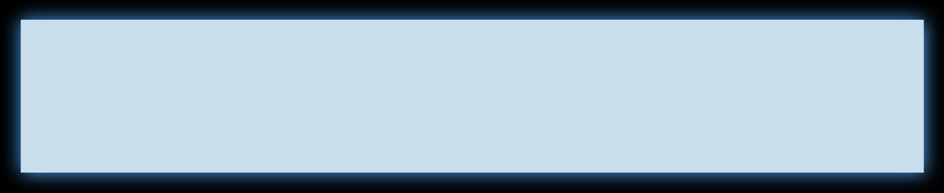

Recommendations for CodeX
Power BI Desktop
Design
Prize
Flavor
Marketing
Brand Ambassador
Offers

Slide 24
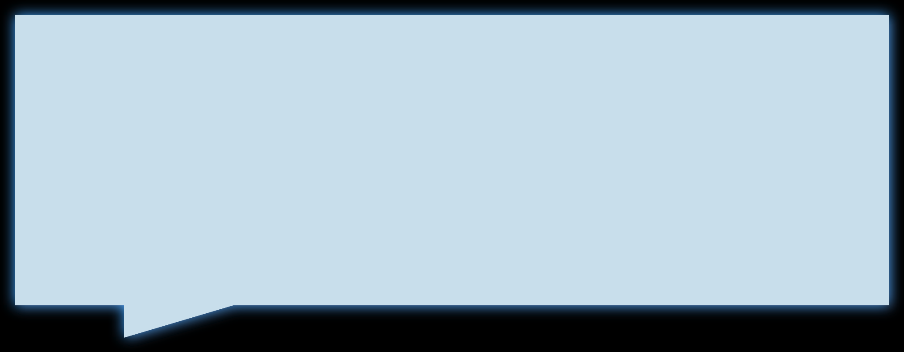
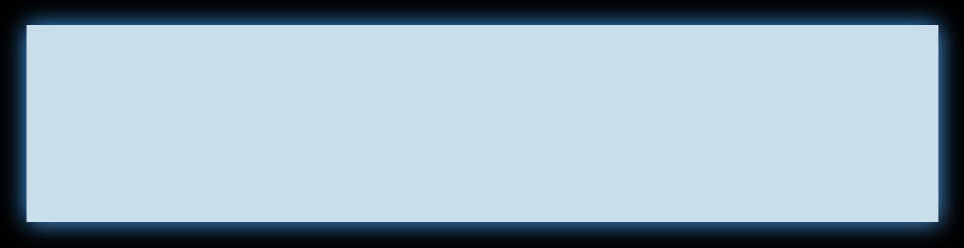

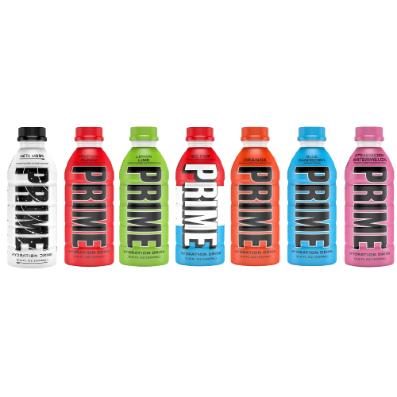
To create a competitive edge in bottle design, prioritize clean and simple aesthetics, avoiding excessive content. A minimalistic approach similar to brands like Prime can enhance the appeal and attract consumers.
Power BI Desktop
a) Design
Compact and portable cans
4.0K
Innovative bottle design
3.0K
Collectible packaging
1.5K
Eco-friendly design
1.0K
Other
0.5K

Slide 25

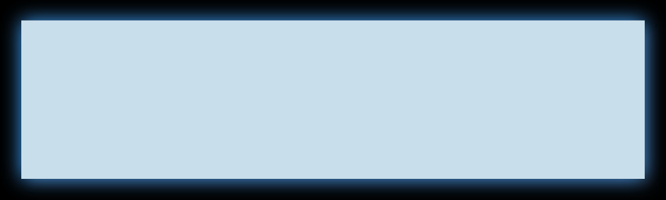
Based on the respondents' preferences and the price range in the market, setting the price of energy drink at 100 would align with their expectations and market trends.
Power BI Desktop
b) Prize
50-99
4.3K
100-150
3.1K
Prize Rs 100
Above 150
1.6K
Below 50
1.0K

Slide 26

c) Flavor
Power BI Desktop
Reduced sugar content
3.0K
More natural ingredients
2.5K
Offering multiple choice flavors can indeed be an effective strategy to attract more customers.
This allows customers to choose flavors that align with their personal preferences, making
your energy drink more appealing and increasing the likelihood of repeat purchases. It's important to conduct market research and
consider popular flavor trends to determine the flavors that are likely to resonate with your target audience.
Wider range of flavors
2.0K
Healthier alternatives
1.5K
Other
1.0K

Slide 27

c) Flavor
Power BI Desktop
Top 10 most liked flavors in India
Reduced sugar content
3.0K
Citrus (such as lemon, lime, or orange)
Berry (including flavors like strawberry, blueberry, or mixed berry)
Tropical (such as pineapple, mango, or passion fruit)
Green Apple
Cola or cola-inspired flavors
Mojito or other minty flavors
More natural ingredients
2.5K
Wider range of flavors
2.0K
Healthier alternatives
1.5K
Other
1.0K

Slide 28
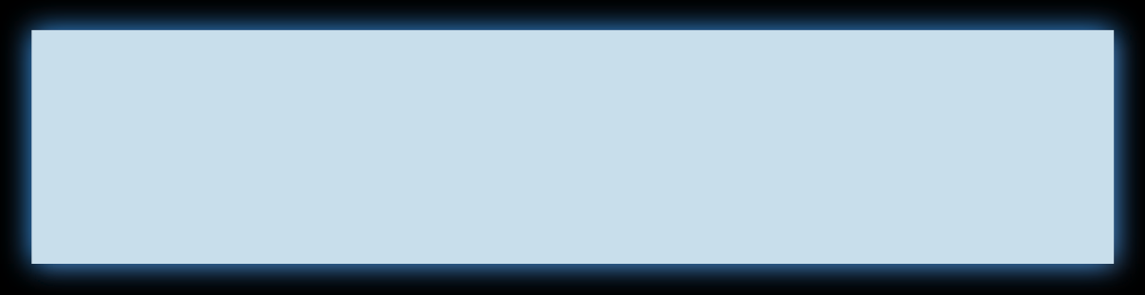
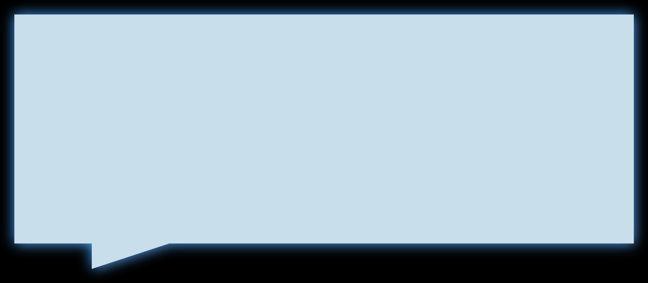



d) Marketing
Power BI Desktop
Online ads and TV commercials are the most effective marketing channels, as indicated by the bar chart.
Age
31-65+ vs 15-30
903
3.4K
647
1.8K
TV
commercials
Online ads
Online ads
TV
commercials

Slide 29
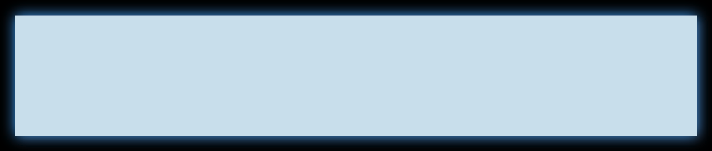


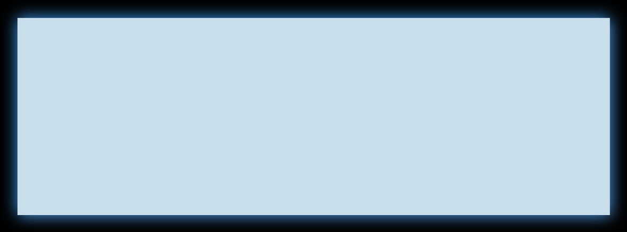
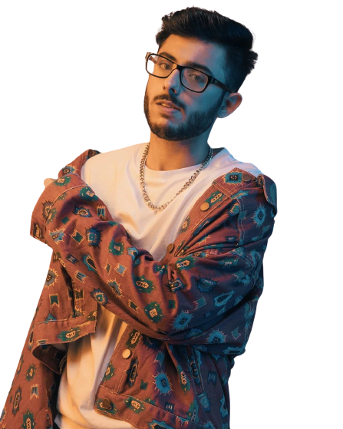
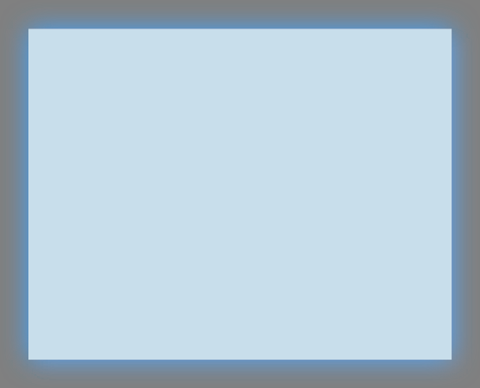

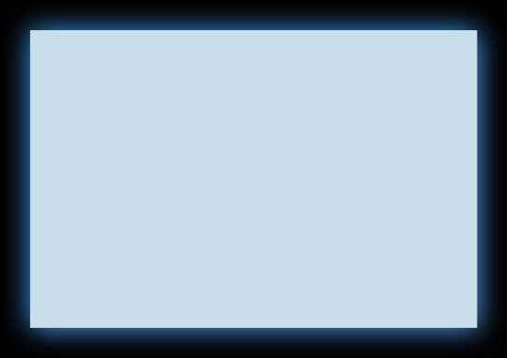

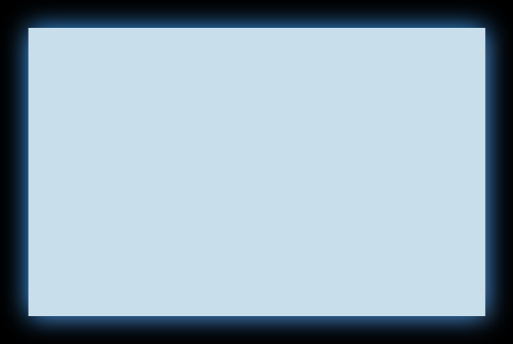
CARRYMINATI
(Ajey Nagar)
Power BI Desktop
e) Brand Ambassador
YouTube
39M
Twitter
3M
Instagram
17.6M

Slide 30

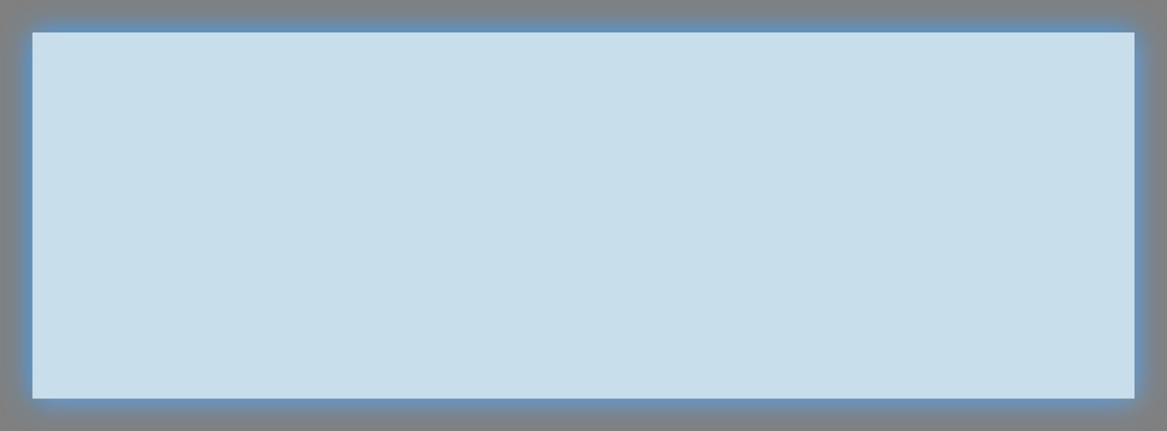

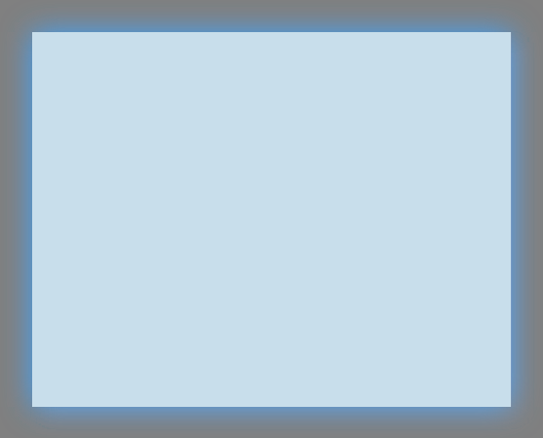

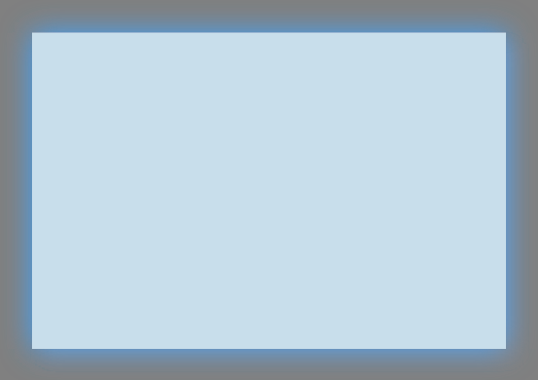
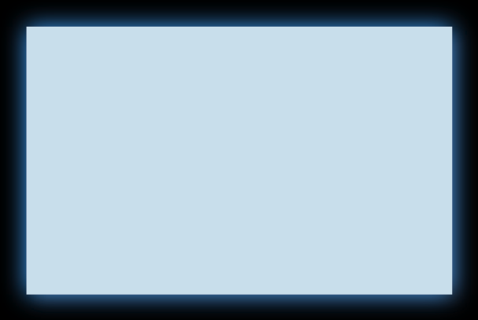
Power BI Desktop
# Large Audience Reach: # Targeting the Youth:
# Influencer Endorsement: # Engaging and Entertaining Content:
# Social Media Impact:
e) Brand Ambassador
CARRYMINATI
(Ajey Nagar)
YouTube
39M
Twitter
3M
Instagram
17.6M

Slide 31


f) Offers
Power BI Desktop
Exclusive Discount Codes:
Giveaway Contest:
Limited Edition Merchandise:
Collaborative Content:
Fan Engagement Events:

Slide 32

f) Offers
Power BI Desktop
Exclusive Discount Codes:
Giveaway Contest:
Limited Edition Merchandise:
Collaborative Content:
Fan Engagement Events:
Offer CarryMinati's followers unique discount codes that they can use to purchase our energy drink at a discounted price. This creates a sense of exclusivity and rewards his audience for their engagement.

Slide 33
f) Offers
Power BI Desktop
Exclusive Discount Codes:
Giveaway Contest:
Limited Edition Merchandise:
Collaborative Content:
Fan Engagement Events:
Host a giveaway contest on
CarryMinati's social media platforms where his followers have a chance to win a bundle of our energy drinks or exclusive merchandise. This encourages participation, engagement, and brand awareness.

Slide 34
f) Offers
Power BI Desktop
Exclusive Discount Codes:
Giveaway Contest:
Limited Edition Merchandise:
Collaborative Content:
Fan Engagement Events:
Create limited edition merchandise, such as co-branded t-shirts or accessories featuring CarryMinati and our energy drink branding. Offer these as special incentives or giveaways to his audience.

Slide 35
f) Offers
Power BI Desktop
Exclusive Discount Codes:
Giveaway Contest:
Limited Edition Merchandise:
Collaborative Content:
Fan Engagement Events:
Produce engaging and entertaining content in collaboration with
CarryMinati, showcasing the benefits and unique features of our energy drink. This can include fun challenges, taste tests, or behind-the-scenes content.

Slide 36
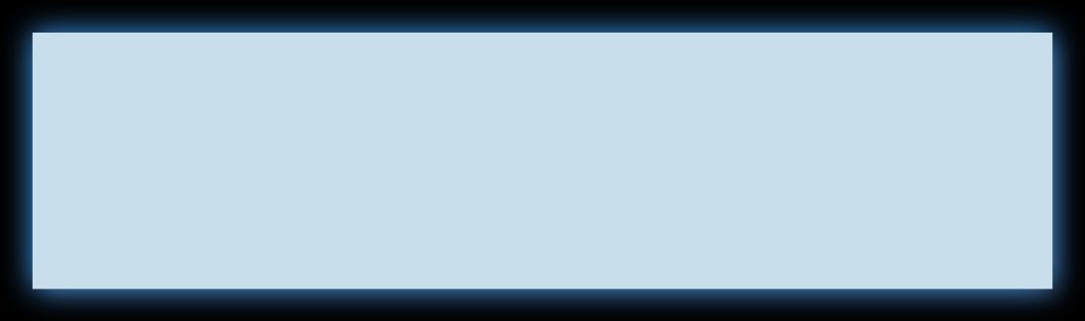
f) Offers
Power BI Desktop
Exclusive Discount Codes:
Giveaway Contest:
Limited Edition Merchandise:
Collaborative Content:
Fan Engagement Events:
Organize fan meet-ups or live events where CarryMinati interacts with his followers and offers them the opportunity to try our energy drink firsthand. This creates a memorable experience and strengthens the connection between CarryMinati's

Slide 37
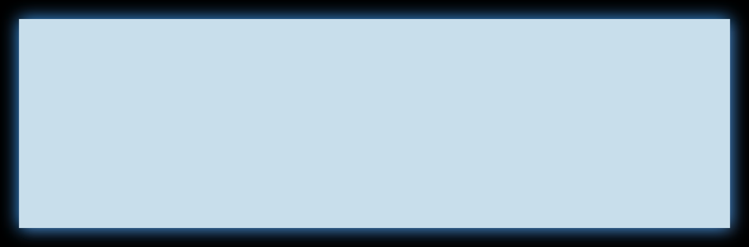


THANK YOU!
Power BI Desktop
❤

